Slide 1

Note: The data and information in this document is reflective of a hypothetical situation and client. This document is to be used for KPMG Virtual Internship purposes only.
Sprocket Central Pty Ltd
Data analytics approach
[Division Name] - [Engagement Manager], [Senior Consultant], [Junior Consultant]

Slide 2
Note: The data and information in this document is reflective of a hypothetical situation and client. This document is to be used for KPMG Virtual Internship purposes only.
Agenda
Introduction
Data Exploration
Model Development
Interpretation

Slide 3
Note: The data and information in this document is reflective of a hypothetical situation and client. This document is to be used for KPMG Virtual Internship purposes only.
Introduction
New Customer Analysis
Look into these factors in new customers:
Age distributions
Number of bike purchases in 3 years
Job industry category
Customer’s State
Wealth segment
Product size of previous purchase

Slide 4
Note: The data and information in this document is reflective of a hypothetical situation and client. This document is to be used for KPMG Virtual Internship purposes only.
Data Exploration
Customer Age Distribution
As we can see, mostly our new customers are between 25 to 48 years old.
Number of customers from 48 to 59 years old has big drops on percentages.
There is a slightly increase in number of customers over 59 years old in term of percentages
It looks like the percentages of under 25 years old not really change.

Slide 5
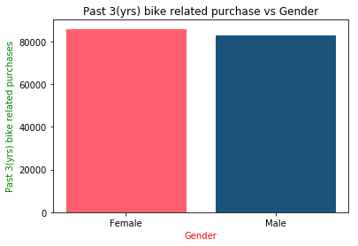
Note: The data and information in this document is reflective of a hypothetical situation and client. This document is to be used for KPMG Virtual Internship purposes only.
Model Development
Bike purchase in last 3 years
As we can see, our new customers mostly Female with 50.6% purchases with total of 25,212 bikes
Male contributed to 47.7% purchases with 23,765 bikes
So we should focus on advertises on Female customers & exciting offers for female.

Slide 6
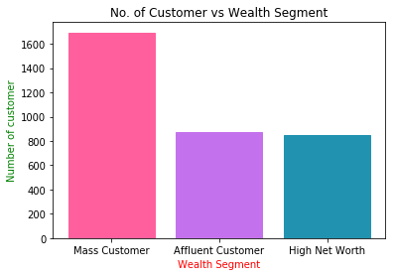
Note: The data and information in this document is reflective of a hypothetical situation and client. This document is to be used for KPMG Virtual Internship purposes only.
Interpretation
Customer Wealth Segment
In all ages, the number of Mass Customers is the highest so we should focus on this class of society.
After that, we should focus on Affluent Customer.
There is tiny difference in high net and affluent customers, so we should focus on both.

Slide 7
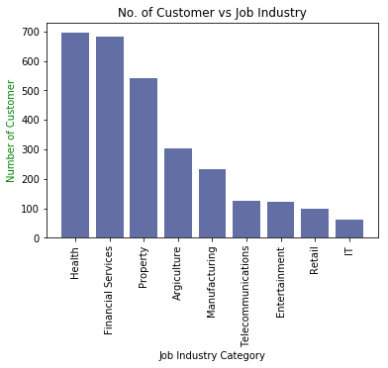
Note: The data and information in this document is reflective of a hypothetical situation and client. This document is to be used for KPMG Virtual Internship purposes only.
Interpretation
Job Industry Category
Most customers belongs to Health and Finance Services.
Focus to attract health or finance industry and mainly female customers.
There is very lesser chance of a new customer from IT and retail industry.

Slide 8
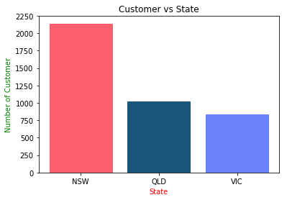
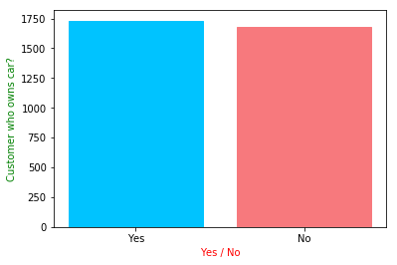
Note: The data and information in this document is reflective of a hypothetical situation and client. This document is to be used for KPMG Virtual Internship purposes only.
Interpretation
Customer State and owns car
Most customers are from New South Wales (NSW)
Also most customers have car.
So, our prime focus on resident of NSW who owns car.

Slide 9
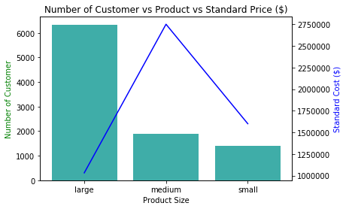
Note: The data and information in this document is reflective of a hypothetical situation and client. This document is to be used for KPMG Virtual Internship purposes only.
Interpretation
Product Size
Large number of customers purchased large size product.
Focus on large size product customers mainly female and resident of NSW.
Also focus on cost of large size product because one of the main reason of their highest selling is low pricing.

Slide 10
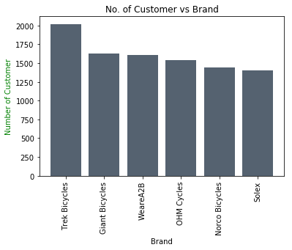
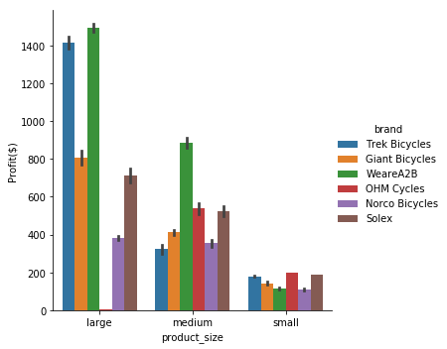
Note: The data and information in this document is reflective of a hypothetical situation and client. This document is to be used for KPMG Virtual Internship purposes only.
Interpretation
Highest selling brands
Trek Bicycles are highest selling brand in all of brands.
Advertise trek bicycles more with female models
Also all product size of trek cycles are profitable.

Slide 11
Note: The data and information in this document is reflective of a hypothetical situation and client. This document is to be used for KPMG Virtual Internship purposes only.
Appendix

Slide 12
Note: The data and information in this document is reflective of a hypothetical situation and client. This document is to be used for KPMG Virtual Internship purposes only.
Appendix
https://github.com/ShuklaPrashant21/KPMG_Virtual_Internship/blob/master/Task_Solutions/KPMG_Virtual_Internship_Data_Visualization.ipynb

